Slide 1
Week 6: Vulnerability Scanning

Slide 2
Information System Setup Overview
Oracle VirtualBox as a Hypervisor
VM Images: Kali Linux, Win2022 VM downloaded from moodle
Vulnerability Scanners: Tenable Nessus running inside Kali VM on port 8834, nmap
Vulnerable Host: Win2022 VM

Slide 3
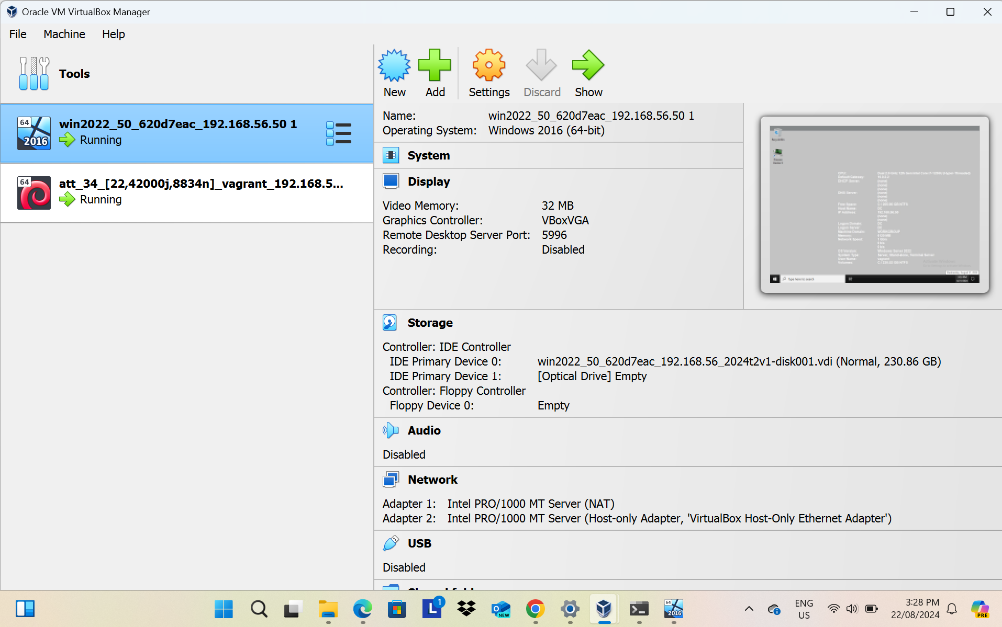
VirtualBox Setup

Slide 4
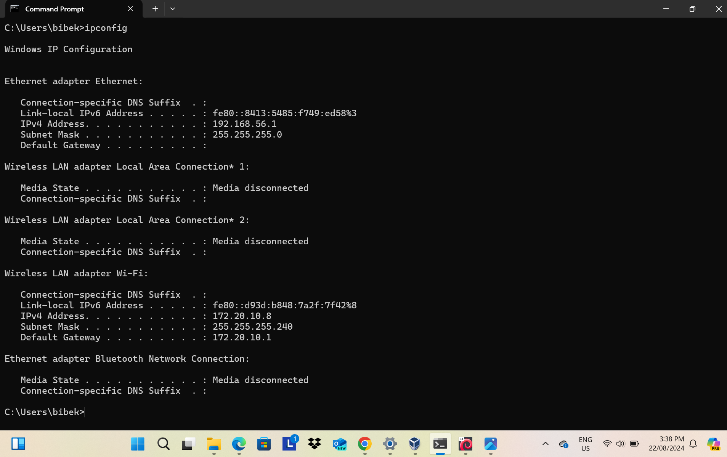
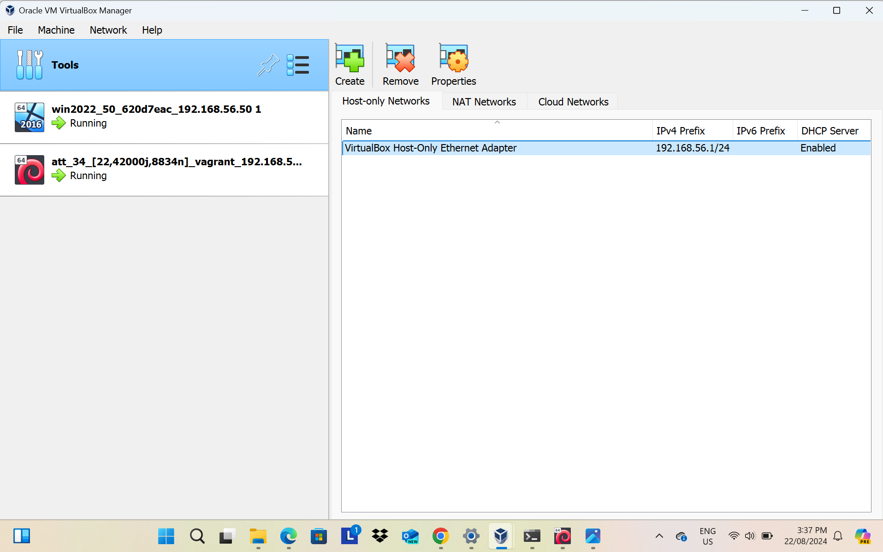
Networking Setup
Kali VM IP: 192.168.56.34
Windows VM IP: 192.168.56.50
Host Machine IP Config
VirtualBox Networking Setup

Slide 5
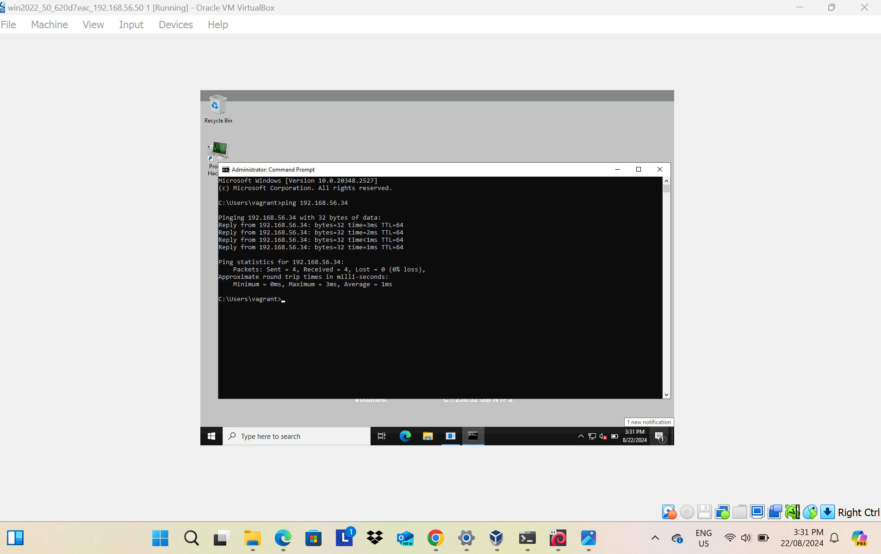
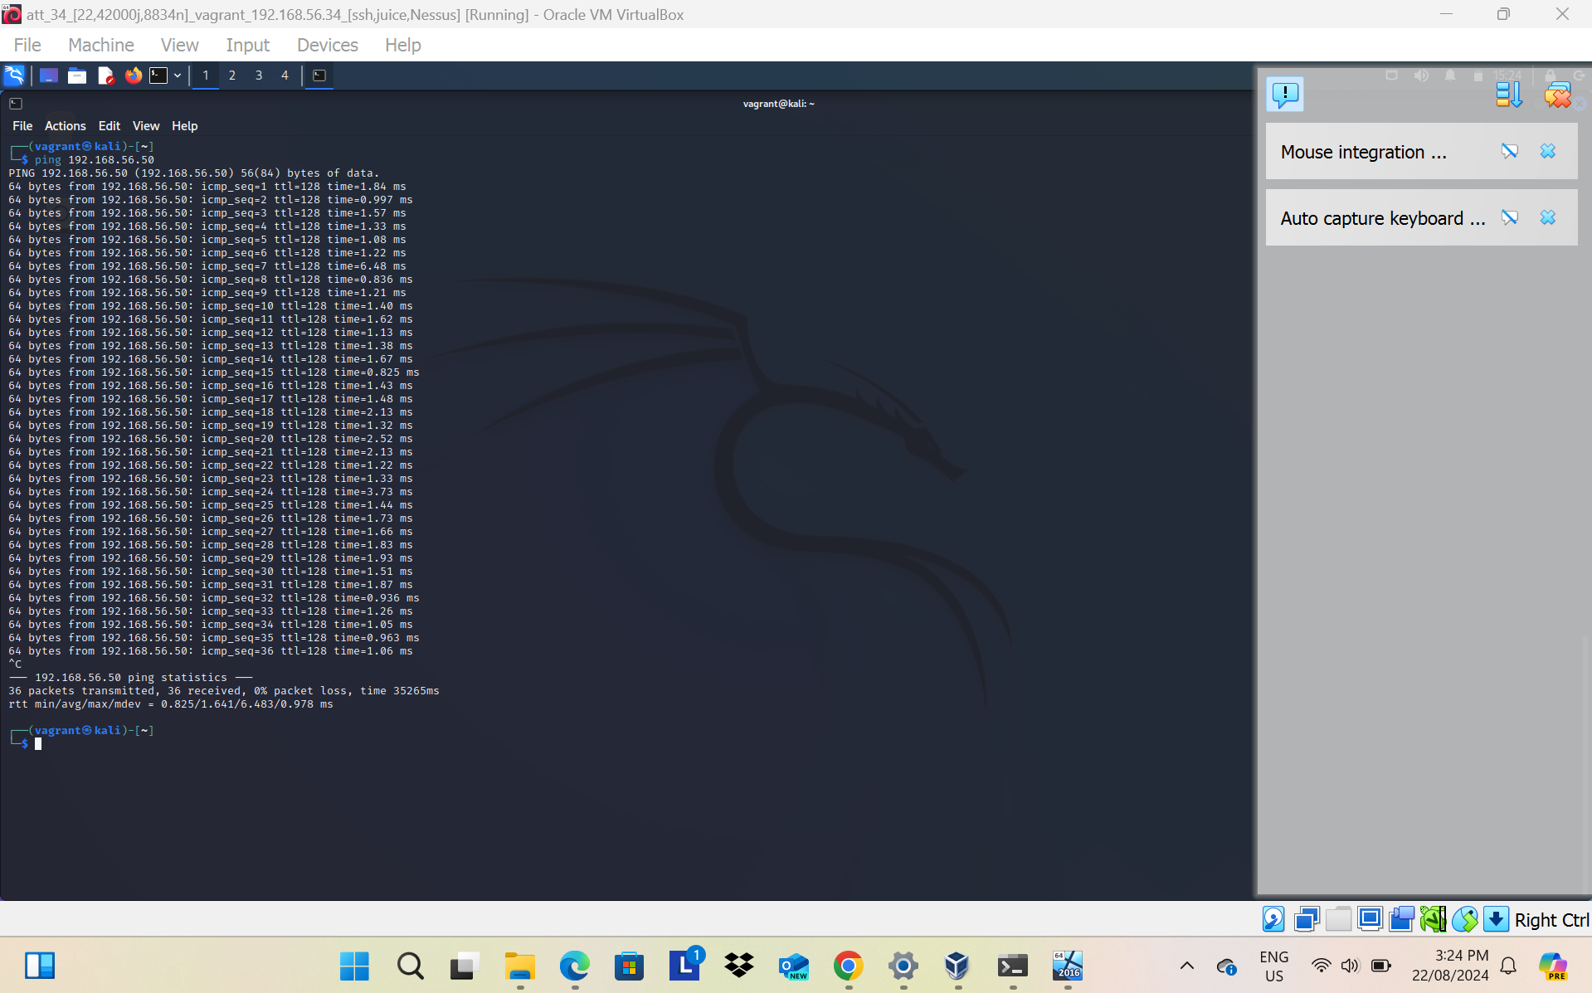
Ping Test
Ping test from Windows VM to Kali VM
Ping test from Kali VM to Windows VM

Slide 6
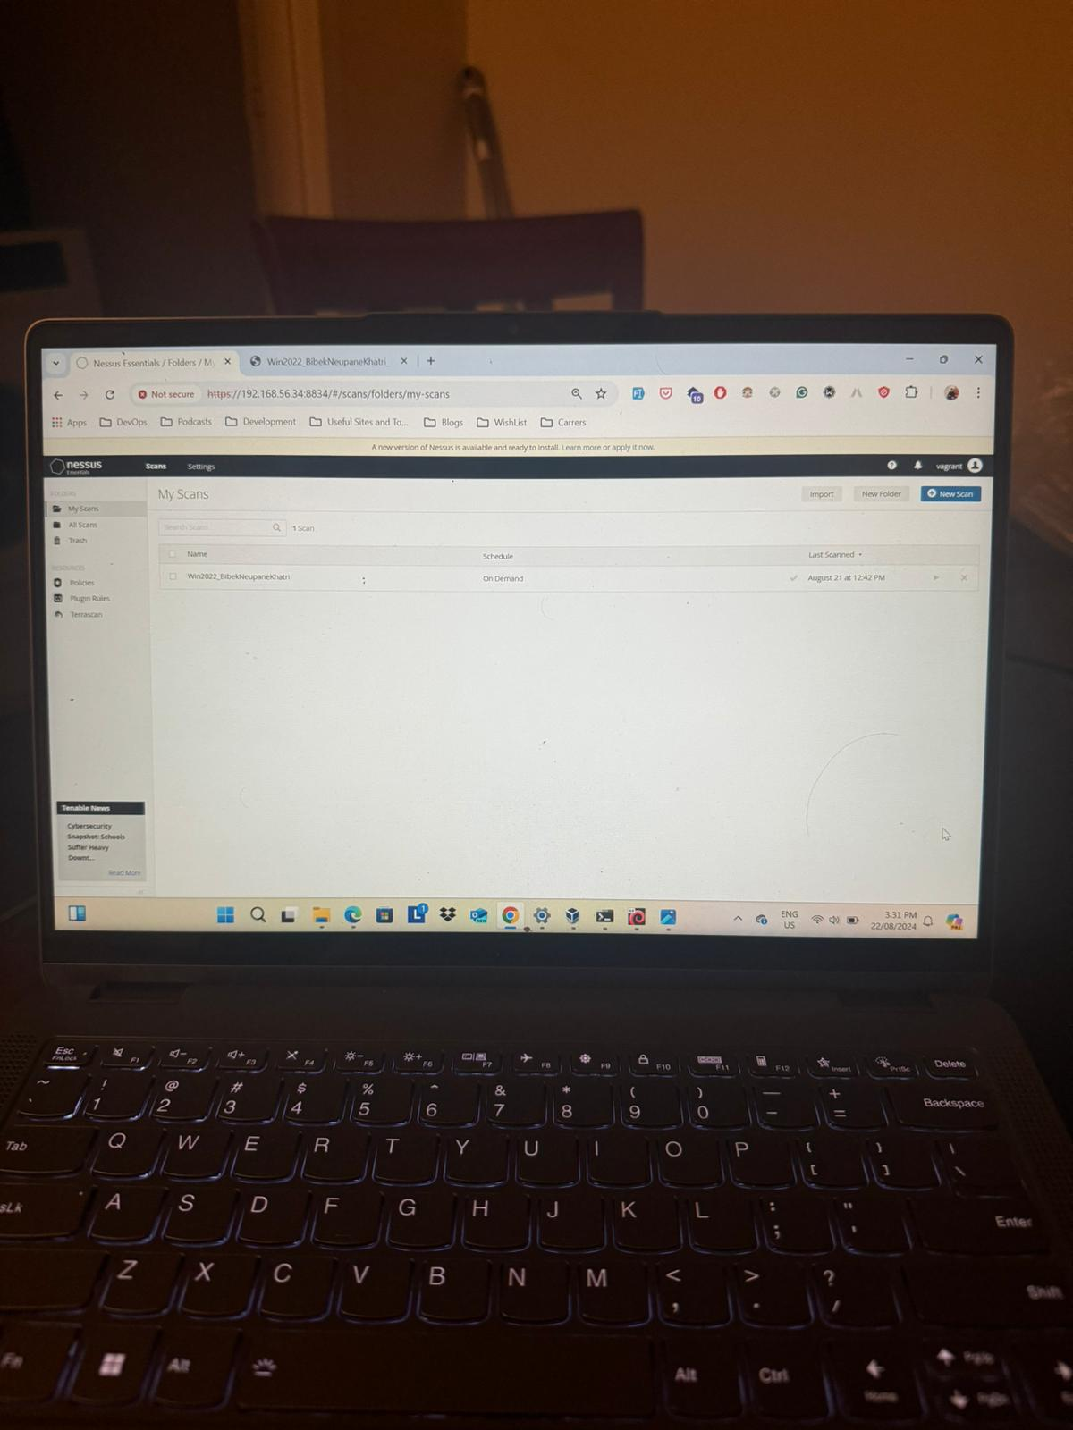
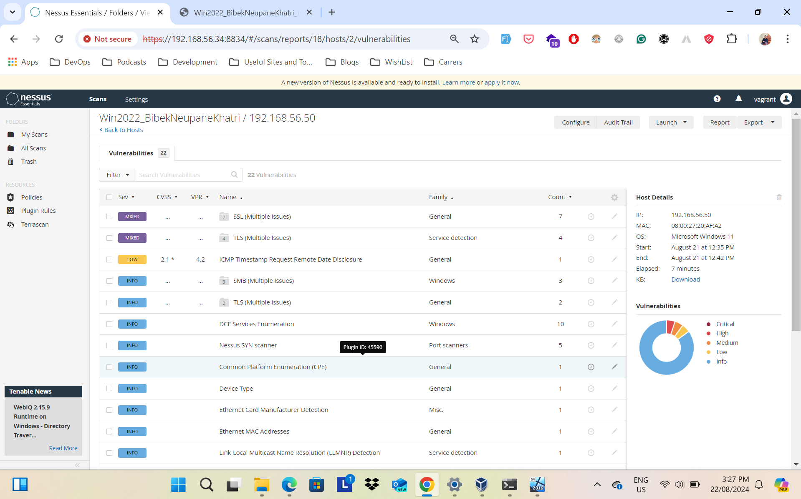
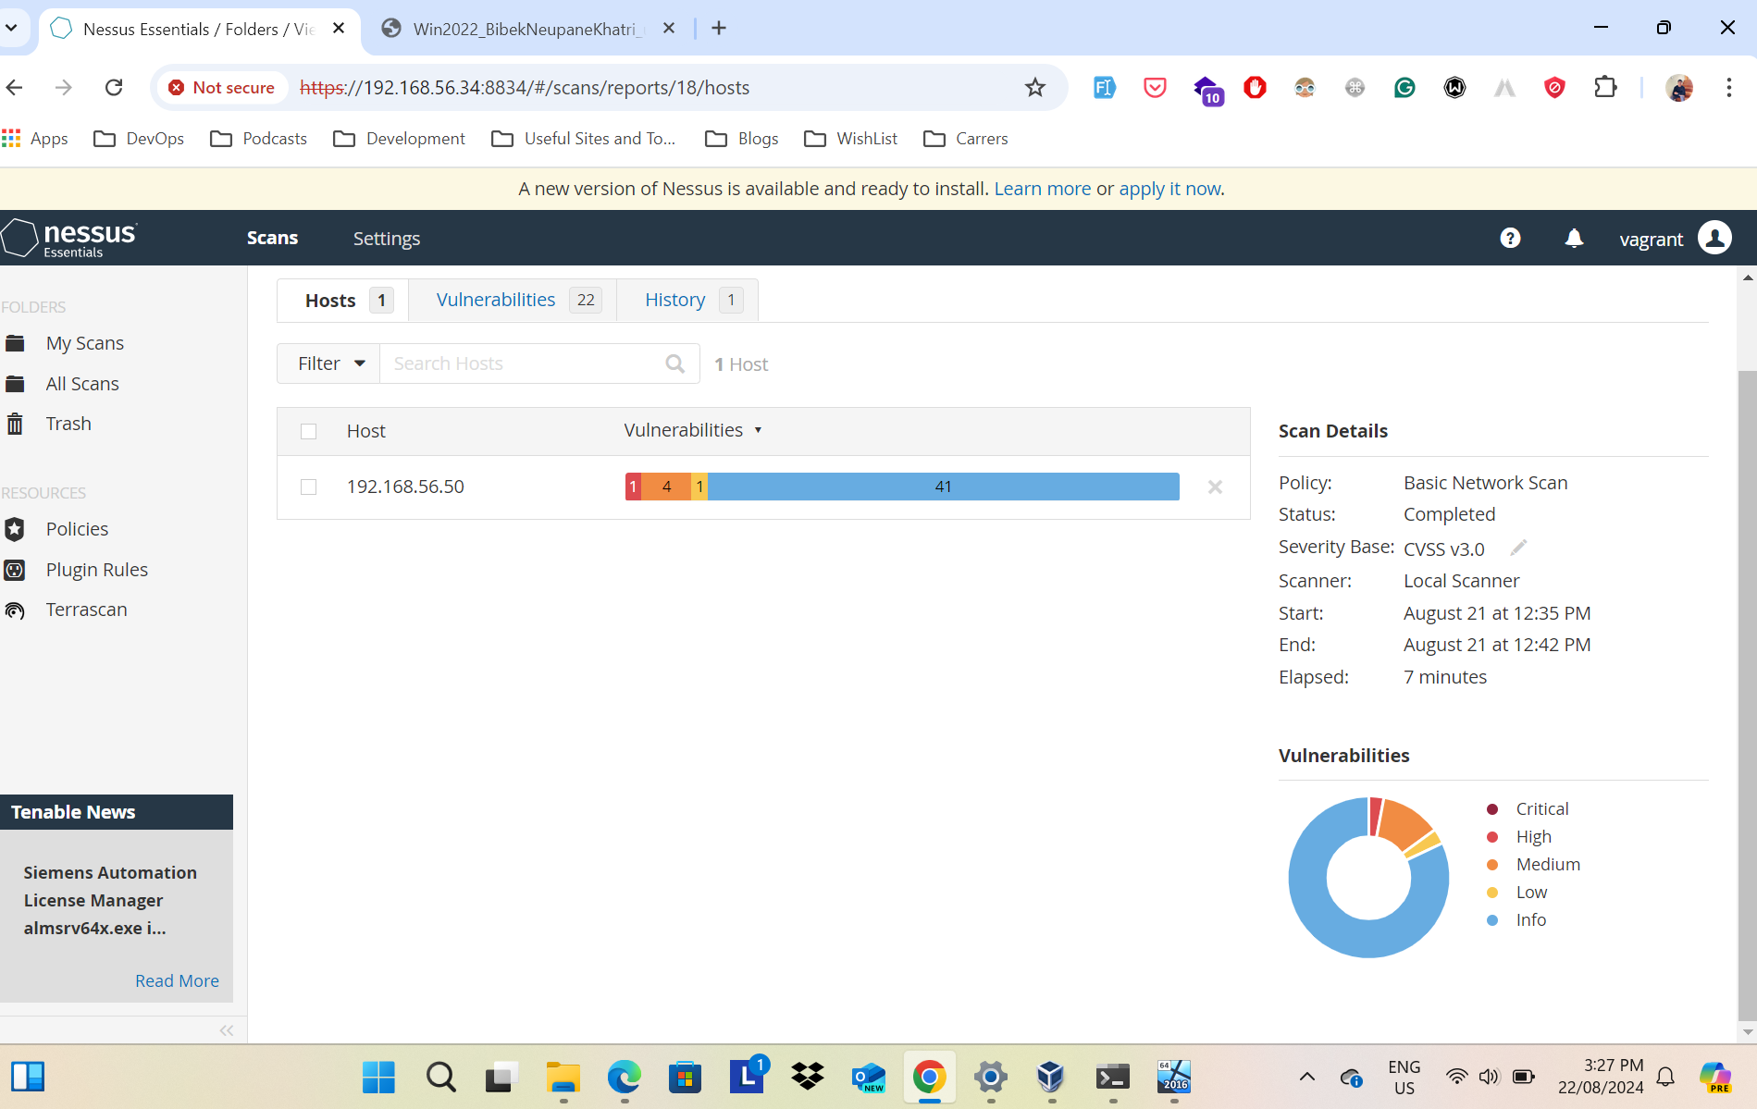
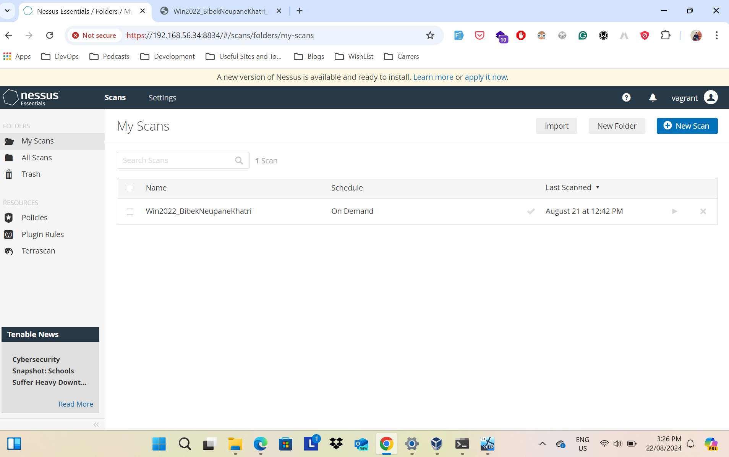
Nessus Scan
The Nessus Scan detailed report PDF artifact can be found in the GitHub repository

Slide 7
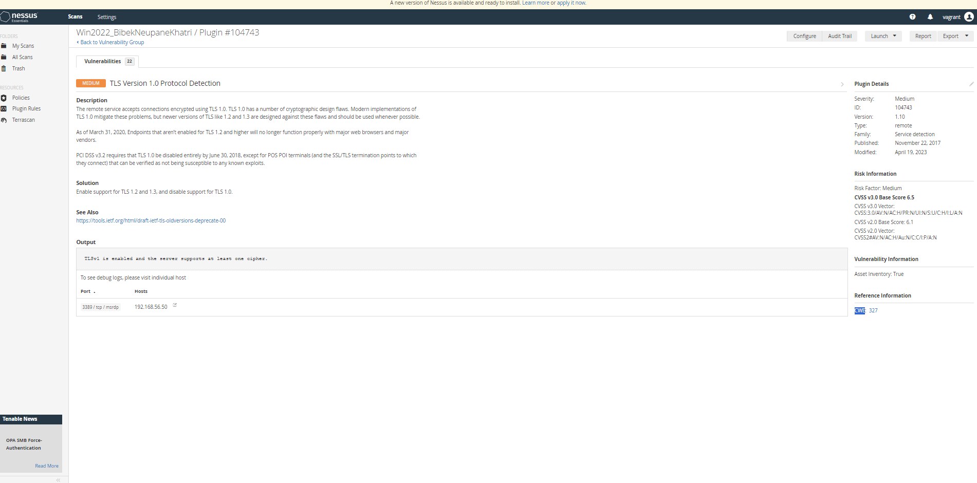
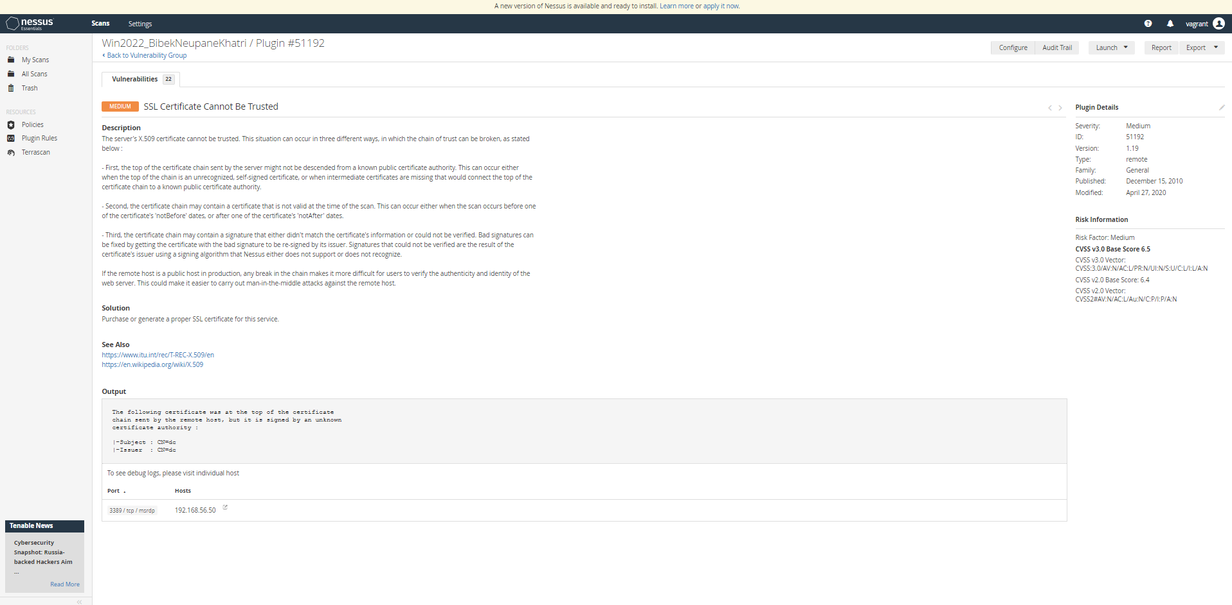
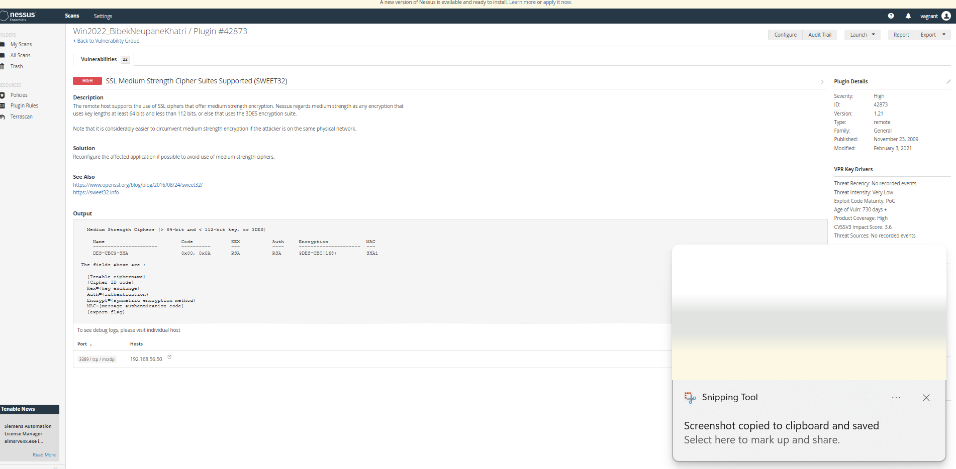
Vulnerabilities

Slide 8
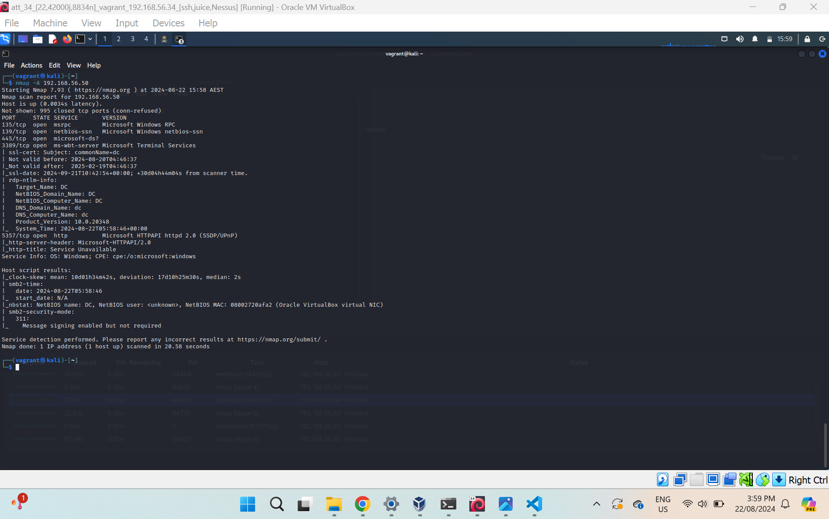
nmap Scan

Slide 9
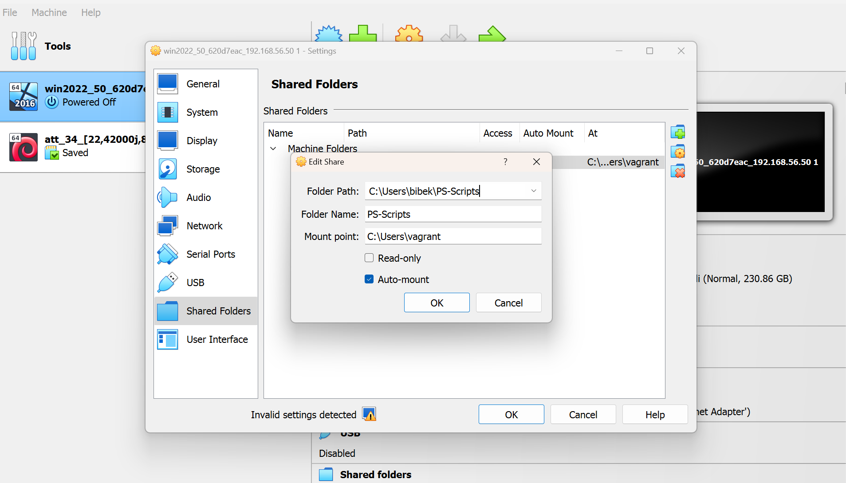
VirtulalBox Shared Folder Settings
The Shared Folders setting must be configured in VirtualBox. This is done to create a sync between host and VM so that scripts are copied that will be used in upcoming weeks to emulate an attack.
This will create a mounted shared folder on the VM on the path Z:\
that will copy all the scripts and changes as well.

